Slide 1

Geometry
Unit 10, Lesson 1 Sectors Volume 2, pg. 119

Slide 2


Benchmark
MA.912.GR.6.4
Solve mathematical and real-world problems involving the arc length and area of a sector in a given circle.
volume 2, pg. 119

Slide 3
Integrated Mathematical Thinking and Reasoning Standards
MA.K12.MTR.1.1 Actively participate in effortful learning both individually and collectively.
MA.K12.MTR.2.1 Demonstrate understanding by representing problems in multiple ways.
MA.K12.MTR.4.1 Engage in discussions that reflect on the mathematical thinking of self and others.
MA.K12.MTR.5.1 Use patterns and structure to help understand and connect mathematical concepts.
MA.K12.MTR.7.1 Apply mathematics to real-world contexts.
volume 2, pg. 119

Slide 4

Learning Targets
I can define a sector of a circle.
I can explain how the area of a sector is defined as a fractional part of the area of a circle.
volume 2, pg. 119

Slide 5

Warm-Up
volume 2, pg. 119

Slide 6
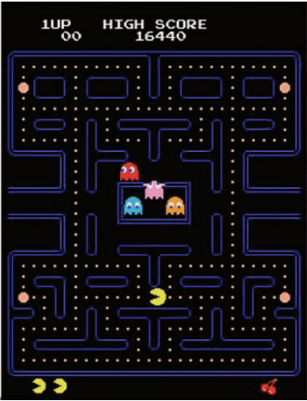
10.1.1 Warm-Up: Pac-Man
The classic and popular Pac-Man video game was released in Japan in May of 1980 and was in the United States by October of that same year. The yellow, pie-shaped character travels around a maze trying to eat dots while avoiding the ghosts hunting him.
volume 2, pg. 119

Slide 7

What do you notice about Pac-Man’s body as he opens and closes his mouth to eat the dots?
What do you wonder as you watch Pac-Man move around the maze?
Watch the video of Pac-Man going around the maze and eating dots.
volume 2, pg. 119

Slide 8

Exploration
volume 2, pg. 120

Slide 9

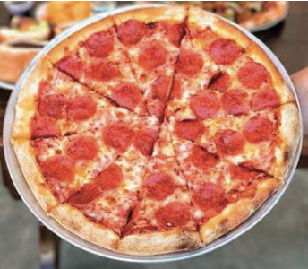
10.1.2 Exploration: Fractions of a Circle
Work with your partner to complete the following.
Pizza sizes are given in terms of the pizza’s diameter. The standard size for most large circular pizzas is 14 inches (in.) and it is usually cut into 10 triangular slices.
volume 2, pg. 120

Slide 10
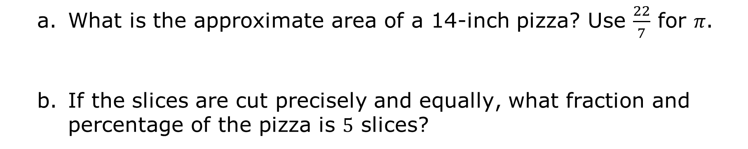
What is the approximate area of a 14-inch pizza? Use $\frac{22}{7}$ for 𝜋.
If the slices are cut precisely and equally, what fraction and percentage of the pizza is 5 slices?
Fraction | Percentage
volume 2, pg. 120

Slide 11
What is the area of 5 slices?
What is the area of 1 slice?
volume 2, pg. 120

Slide 12

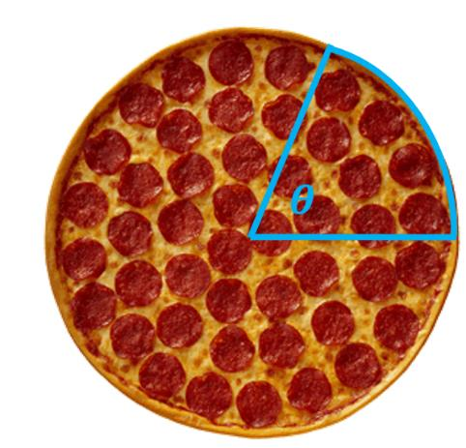
The point where a pizza is divided to create precisely equal slices is a central angle.
The central angle is a fraction of the total 360° in a circle.
A central angle is an angle with its vertex at the center of a circle with radii as its side.
volume 2, pg. 120

Slide 13
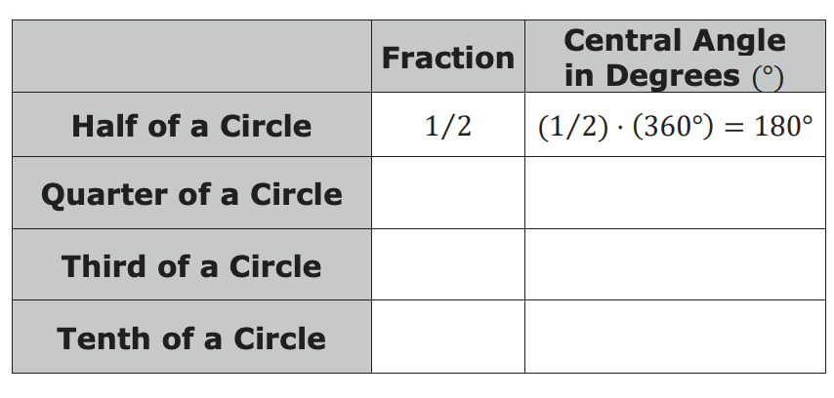
Complete the table. The first row of the table has been filled in.
volume 2, pg. 120

Slide 14
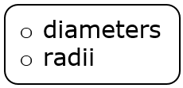
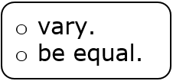
Complete the statement.
One slice, or fraction of the circle, is bounded by two and an arc. Since each slice is the same size, the central angle for each fractional piece of the circular pizza will
The pizza slices are an example of sectors. With your partner, write a definition of the term sector.
volume 2, pg. 121

Slide 15
Ask two other partner pairs to share their definition of a sector. Record a summary of their definition. You are the only person who should write in the first column of the table. Have the person initial next to your summary stating that your summary was correct.
My Summary of Their Definition of a Sector | Initials
volume 2, pg. 121

Slide 16

Guided Practice
volume 2, pg. 121

Slide 17

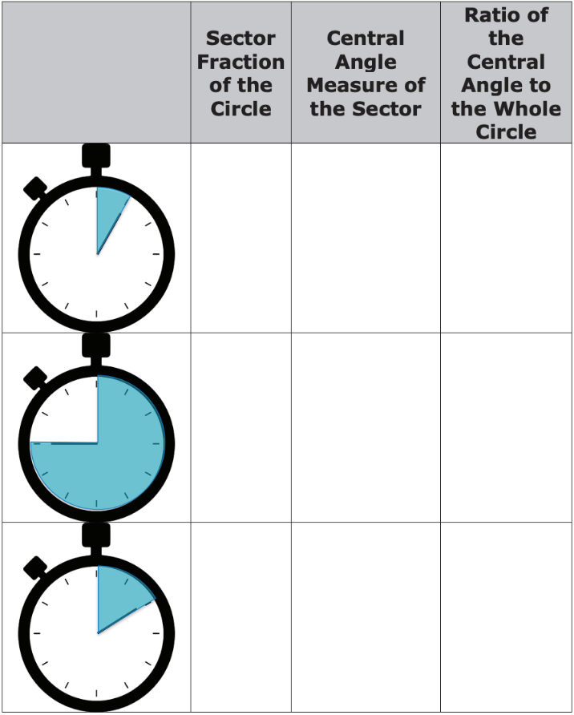
10.1.3 Guided Practice: Finding the Area of a Sector
The images show a stopwatch with different time increments marked. The blue shading on the stopwatches each forms a sector.
Complete the table.
volume 2, pg. 121

Slide 18
Summarize what you notice about the relationship between the values in each row.
Discuss with your partner how ratios could be used to find the area of the sectors, including any additional information that might be needed. Summarize your discussion.
volume 2, pg. 122

Slide 19
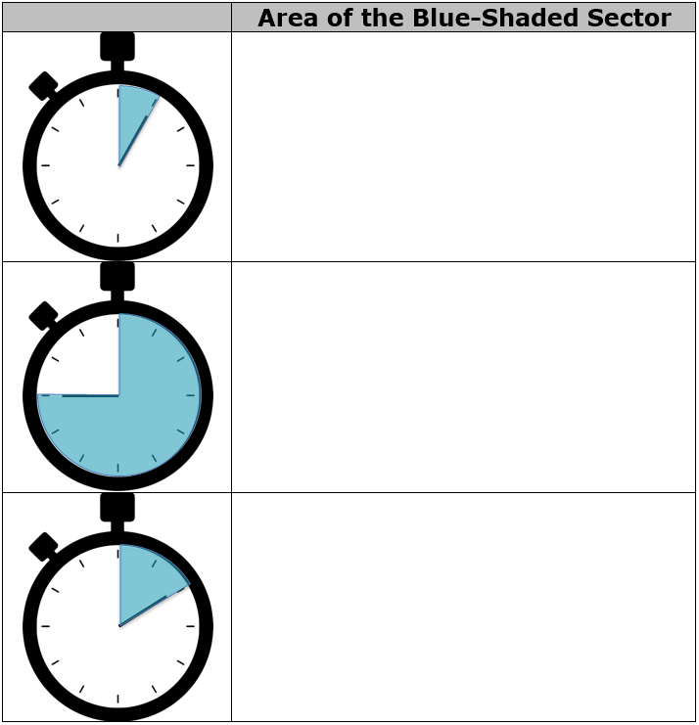
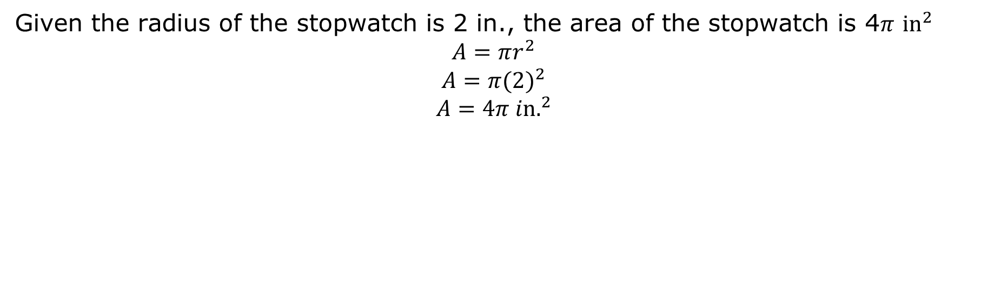
Given the radius of the stopwatch is 2 in., the area of the stopwatch is 4𝜋 ${in}^{2}$
$$A=πr^{2}$$
$$A=π{(2)}^{2}$$
$$A=4π {in.}^{2}$$
Use the relationship between each sector and the whole stopwatch explored in problem 1 to find the area of each sector. Show your work.
volume 2, pg. 122

Slide 20

Your Turn
volume 2, pg. 123

Slide 21
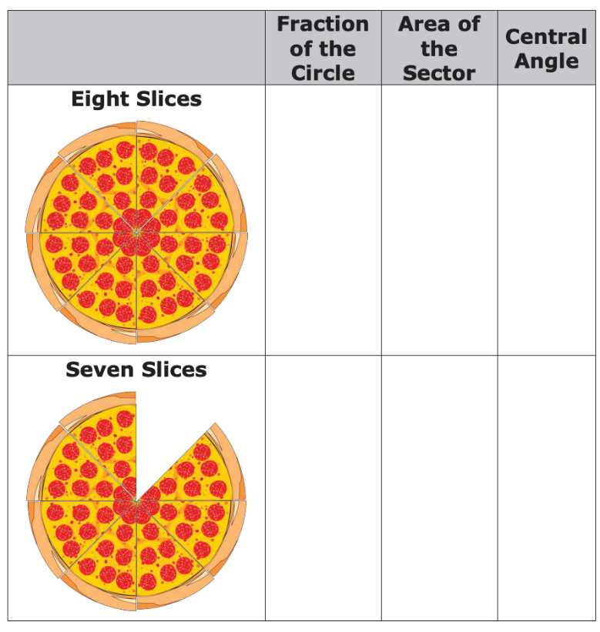
10.1.4 Your Turn!
Kenya orders a medium pizza that has a 8 in. radius. Complete the table on the number of slices she has.
volume 2, pg. 123

Slide 22
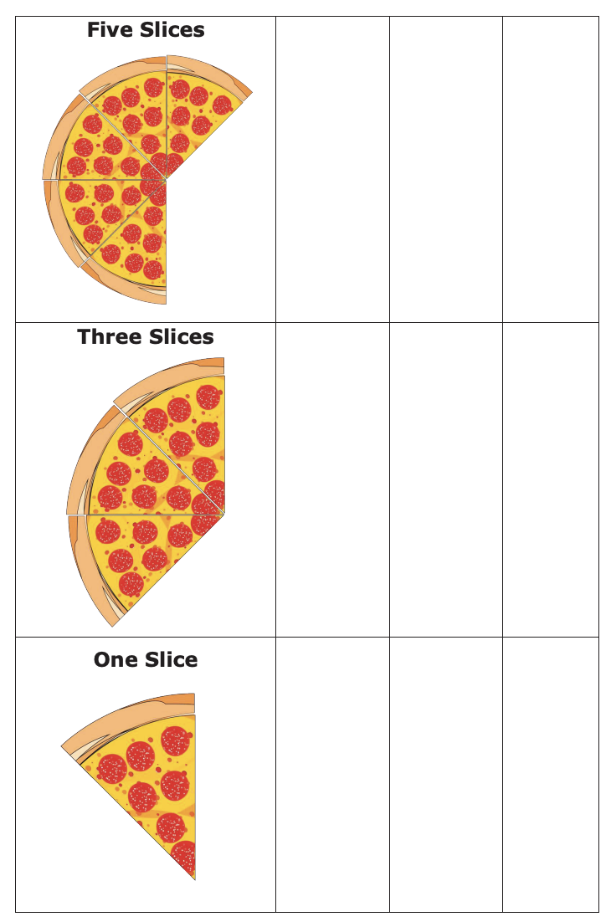
volume 2, pg. 123

Slide 23

Wrap-Up
volume 2, pg. 124

Slide 24
10.1.5 Wrap-Up: Cool Down
Write an explanation to a classmate who might have missed today’s lesson, in your own words, about sectors.
volume 2, pg. 124

